Slide 1
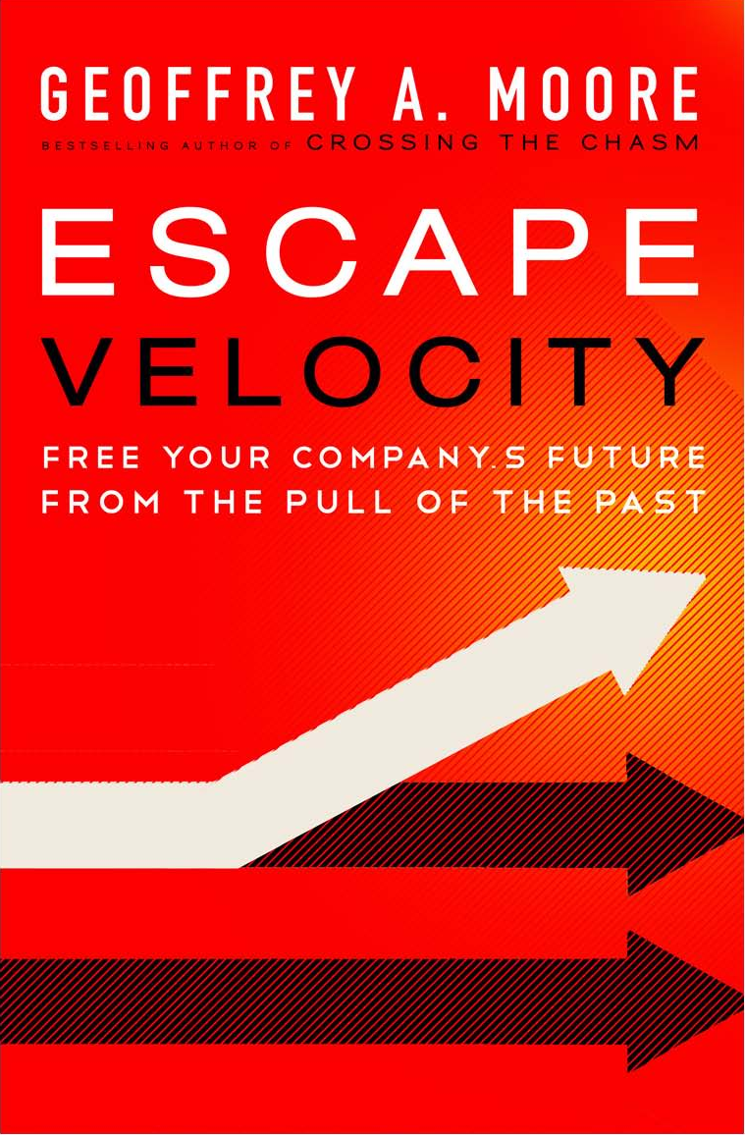
HarperCollins
Paper & eBook format
Release Date: Sept 6, 2011

Slide 2
Category Maturity Life Cycle
Indefinitely elastic middle
A
B
C
D
E
Revenue Growth
Emerging
Categories
Growth
Categories
Mature
Categories
Declining
Categories
End of
Life
Technology Adoption
Life Cycle
Time
Fault Line!
Figure 2.1
Notes:
2

Slide 3
Portfolio Management
The Growth/Materiality Matrix
High
Growth
Low
Growth
Material
Growth
Mature
2
3
1
4
Not
Material
Emerging
Declining
Figure 2.2

Slide 4
Typical Portfolio Pattern
High Growth
Categories
Low Growth
Categories
Material to Current Financials
2
3
1
4
Not Material
Figure 2.3

Slide 5

Managing a Portfolio
The Three Horizons Model
High Growth Businesses
Today’s revenue growth + tomorrow’s cash flow
Horizon 3
36 to 72 months
Current Businesses
Generate today’s cash flow
Accumulated Total Returns
Growth Options
Options on future
high-growth businesses
Horizon 2
12 to 36 months
Horizon 1
0 to 12 months
Expected Window of Returns
Figure 2.4
Notes:
030326HKO_MOT057_v1i
5

Slide 6
Three Horizons Model Mapped to
Growth/Materiality Matrix
High
Growth
Low
Growth
Horizon 1
Material
Horizon 2
“Horizon 0”
Not
Material
Horizon 3
Figure 2.5

Slide 7
Goals, Metrics, and the Three Horizons
Different Metrics for Each Horizon
TIME FRAME | HORIZON 1 (0 - 12 mos) | HORIZON 2 (12 - 36 mos) | HORIZON 3 (36 - 72 mos)
Driving
Goal
Maximize
Economic Returns
Become a
Going Concern
Create a
Category
Key
Performance
Indicators
Revenue vs. plan
Bookings
Contribution margin
Market share
Wallet share
Target accts vs. plan
Sales velocity
Deal size
Segment share
Time to tipping point
Name-brand customers
Deal size
Name-brand partners
PR buzz
Flagship projects
“Opex”
“Timex”
“Capex”
Figure 2.6

Slide 8
Achieving Escape Velocity
Focus on Competitive Separation
An
Unmatchable
Offer
*
CORE
*
Competitor 1
*
Gain bargaining power by getting separation from your
competitive set
YOU
*
Competitor 2
*
Failure to separate means lower revenues or profit margins or both
Competitor 3
Competitive Set
Figure 3.1

Slide 9
Two Business Architectures
Complex Systems vs. Volume Operations
Sweet
Spot
Sweet
Spot
Effectiveness
Complex
Systems
Volume
Operations
Complexity
Volume
10⁰
10¹
10²
10³
10⁴
10⁵
10⁶
10⁷
10⁸
10⁹
Number of Customers
Government
Programs
Enterprise
Small
Business
Consumer
Societal
Entitlements
Figure 3.2
Notes:
9

Slide 10
9-Point Market Strategy Framework
Key sponsor
1. Target Customer
2. Compelling Reason to Buy
3. Whole Offer
4. Partners and Allies
5. Sales Strategy
6. Pricing Strategy
7. Competition
8. Positioning
9. Next Target
Core problem
Complete solution
Needed for whole product
Function of whole
product complexity
Value based
Legitimate alternatives
Differentiation
Next growth segment
Figure 4.1

Slide 11
Return on Innovation
Differentiation
Neutralization
Failed
Attempts
Optimization
Waste
Figure 5.1

Slide 12
The Six Levers
Free Resources Trapped in Context Tasks
Centralize. Bring operations under a single authority to reduce overhead and create a single point of control to manage mission-critical risk.
Standardize. Reduce the variety and variability of processes delivering similar outputs to eliminate costs and minimize risks.
Modularize. Deconstruct the system into its component subsystems and standardize interfaces for future cost reductions.
Optimize. Eliminate redundant steps, automate standard sequences, streamline remaining operations, substitute lower-cost components, or otherwise cost- and resource-reduce.
Instrument. Characterize the remaining processes in terms of the variability of key parameters and develop monitor-and-control systems to manage their performance.
Outsource. Drive processes out of the enterprise entirely to further reduce overhead, variabilize costs, and minimize future investment. Incorporate vendor use of monitor-and-control systems into Service Level Agreement.
Figure 5.2

Slide 13
Price/Benefit Sensitivity
How Customers Internalize Value
HI
COST
PERFORMANCE
Price Sensitivity
CONVENIENCE
PREMIUM
LO
LO
HI
Benefit Sensitivity
Figure 5.3

Slide 14
Value Disciplines and
Price/Benefit Sensitivity
HI
Operational Excellence
Product Leadership
Price Sensitivity
Customer Intimacy
LO
LO
HI
Benefit Sensitivity
Figure 5.4

Slide 15
Creating the Unmatchable Offer
The Core/Context Model
Core
Unmatchable
Differentiation
Context
Neutralizing
Innovations
Mission
Critical
1
2
Enabling
3
4
Figure 2.1

Slide 16
The Arc of Execution
Complex Systems Enterprises
Playbooks
Deploy
Projects
Products
Invent
Optimize
Figure 6.1

Slide 17
The Arc of Execution
Volume Operations Enterprises
Partners
Deploy
Products
Processes
Invent
Optimize
Figure 6.2

Slide 18
Catalyzing Escape Velocity
The “Tipping Point” Role of Programs
Transition
Program
Transition
Program
Deploy
●
●
Tipping
Point
Tipping
Point
Invent
Optimize
Figure 6.3

Slide 19
Four Modes of Execution
Execution Mode | Invention | Deployment | Optimization | Transitions
Type of Leader | Visionary Inventor | Pragmatic Deployer | Conservative Optimizer | Pragmatic Orchestrator
Core Competence | Creativity | Competitiveness | Control | Collaboration
Core Attribute | Spontaneous | Tough-minded | Prepared | Empathetic
Decision Style | Intuition | Experimentation | Deliberation | Consensus
Functions Most in Alignment | R&D, Creative Services | Sales, Engineering | Finance, Operations | HR, Marketing, Customer Suppt
Figure 6.4

